Slide 1
ADC Module

Slide 2
Agenda
ADC introduction
ADC Techniques
STM32F4 ADC

Slide 3
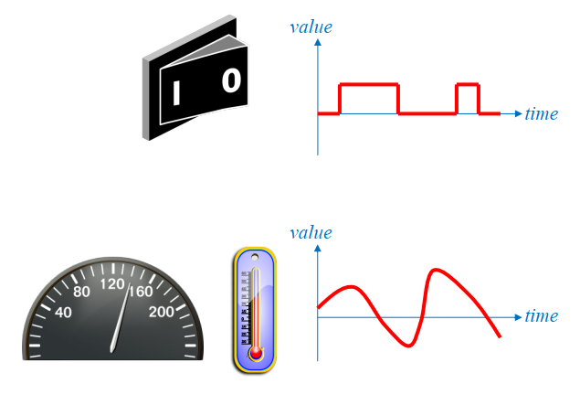
Digital and Analog Signals
Digital signals
Have a limited number of valid values
Analog signals
Have a infinite number of values in a range
In the real world, most signals are available in analog form

Slide 4
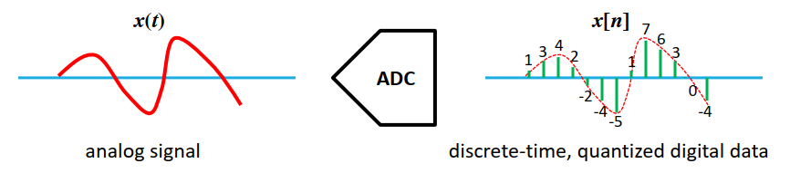
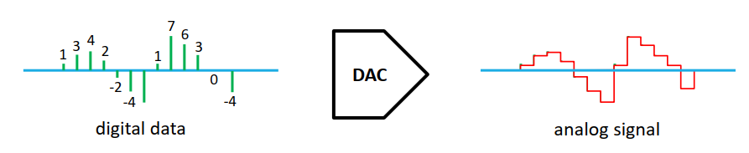
Digital/Analog Conversion
Analog-to-digital converter (ADC)
Digital-to-analog converter (DAC)

Slide 5
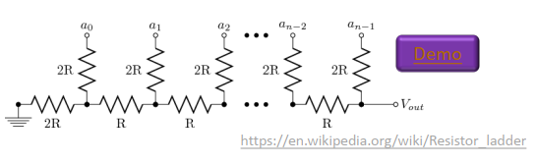
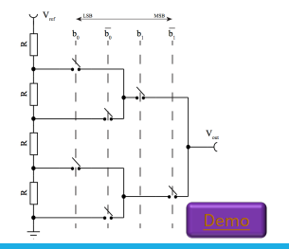
Common ADC/DAC Techniques
PWM + low-pass filter
R-2R ladder
Integrated resistor string

Slide 6
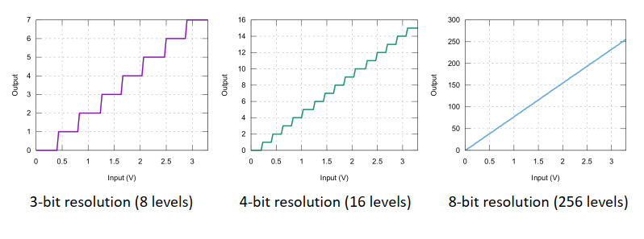
ADC Resolution
The higher the bit resolution, the more accurate the
conversion

Slide 7
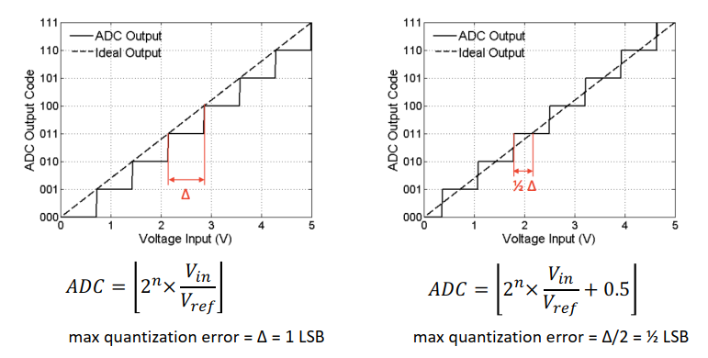
Quantization Error
Suppose #bits = 3; Δ = Vref/23 (aka. 1 LSB)

Slide 8
Common ADC Techniques
Flash / half-flash
Successive approximation
Delta-sigma

Slide 9
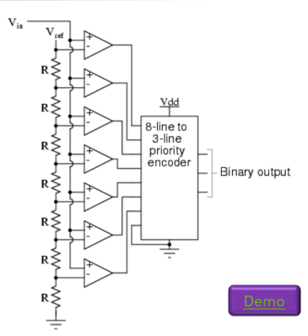
Flash ADC
Fastest ADC
Requires a large number of comparators and resistor (2^{n})

Slide 10
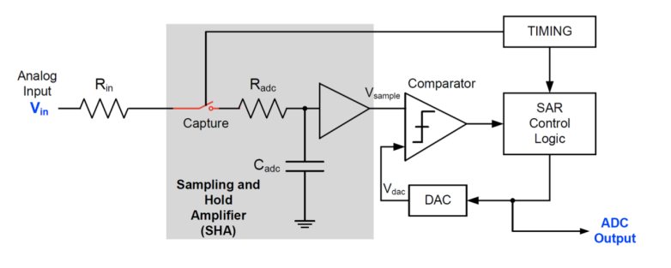
Successive Approximation ADC
Or Successive Approximation Register (SAR)
Binary search - relatively fast and simple to implement

Slide 11
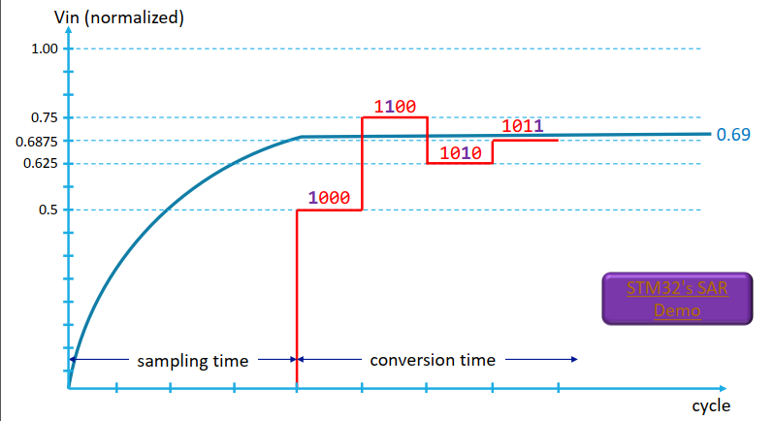
SAR Operation

Slide 12
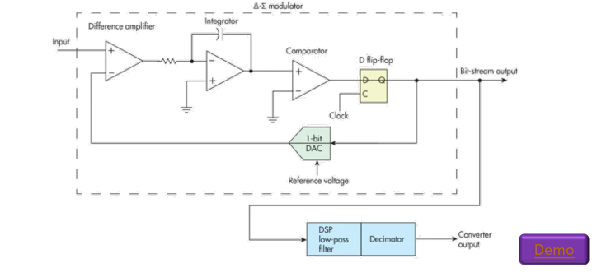
Delta-Sigma ADC
Highest resolution; also slowest
Usually restricted to DC or audio frequencies

Slide 13
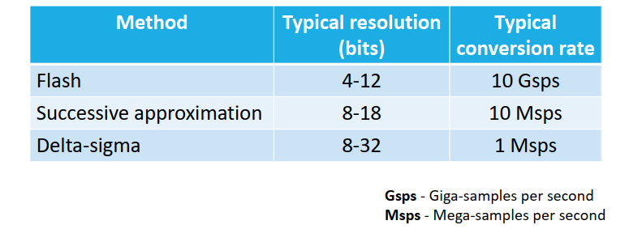
Comparison of ADC Methods

Slide 14
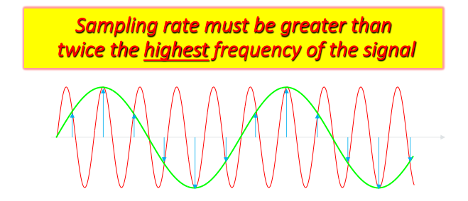
Minimum Sampling Rate
Nyquist Theorem
Input signals must also be properly filtered to eliminate
unwanted high-frequency components

Slide 15
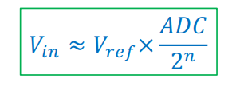
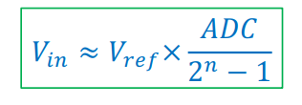
Voltage Calculation
Two variations, depending on ADC:
ADC value at full-scale voltage = 2n
ADC value at a full-scale voltage = 2n – 1
Vin = Input Voltage
ADC = Giá trị quy đổi
N = độ phân giải ( số bit)
Vref = điện áp tham chiếu
Xác định giới hạn đo <= VADC
1.8V, 2.5V, 3.3V

Slide 16
STM32F4x’s Analog Components
1x 12-bit SAR ADC
5.33 Msps max conversion rate with full resolution
Up to 10 external channels and 4 internal channels
Analog watchdog
Single-ended and differential mode inputs
Dual clock domain architecture
2x DAC

Slide 17
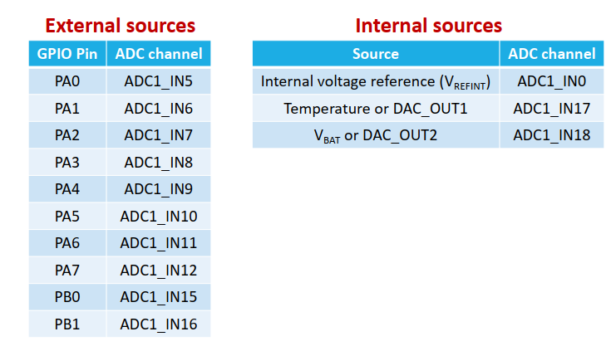
Analog Input Sources

Slide 18
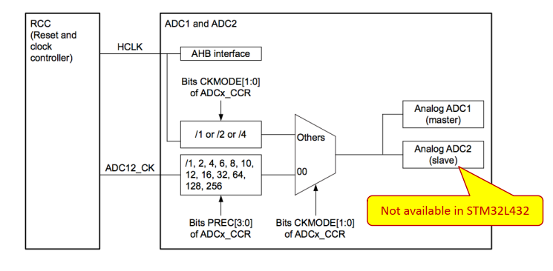
ADC Clock Sources
Selectable from two clock domains

Slide 19
ADC Measurement Time
n → resolution (number of bits) – effective bits = n – 2
Total time = Tsampl + Tconversion
Minimum of 2.5 x ADC_CLKs for Tsampl
Minimum of 12.5 ADC_CLKs for Tconversion (12-bit resolution)
Hence, 5.33 Msps for 80 MHz ADC clock frequency

Slide 20
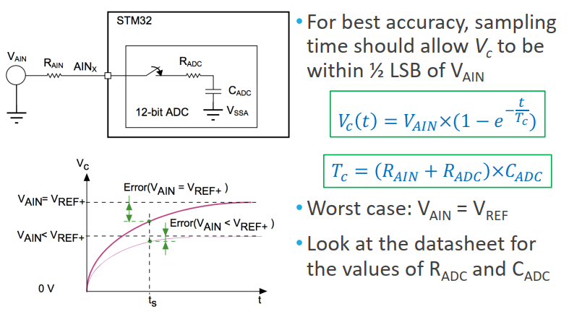
Choosing Sampling Time

Slide 21
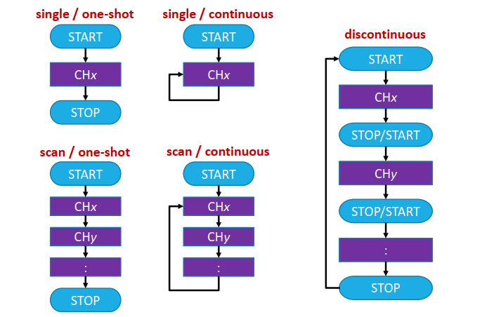
Conversion Modes

Slide 22
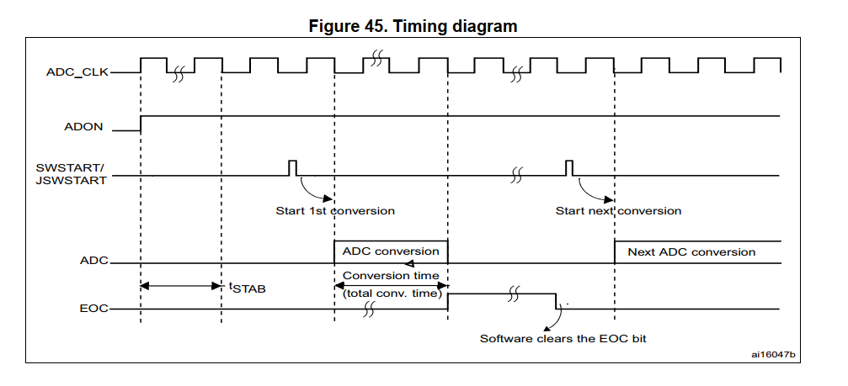
ADC – Timing Diagram

Slide 23
STM32 DMA
DMA: Direct Memory Access
Peripheral ⬄ RAM
RAM ⬄ RAM
TBD

Slide 24
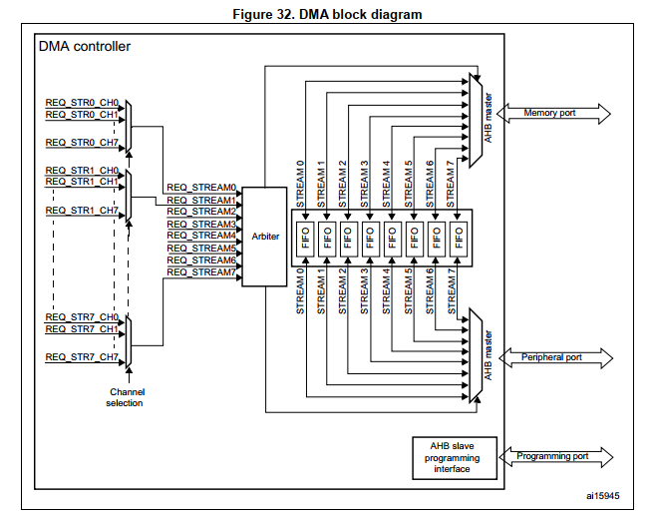
STM32 DMA: Block Diagram

Slide 25
STM32 DMA Features
Dual AHB master bus architecture, one dedicated to memory accesses and one dedicated to peripheral accesses
Independent source and destination transfer width (byte, half-word, word): when the source and destination data widths are different
Independent Incrementing or Non-Incrementing addressing for source and destination. Possibility to set increment offset for peripheral address.

Slide 26
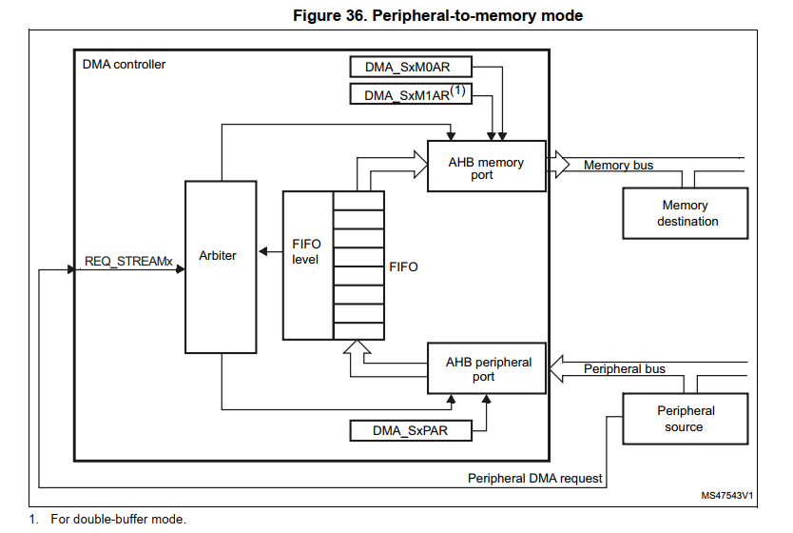
DMA – Peripheral to Memory Mode

Slide 27
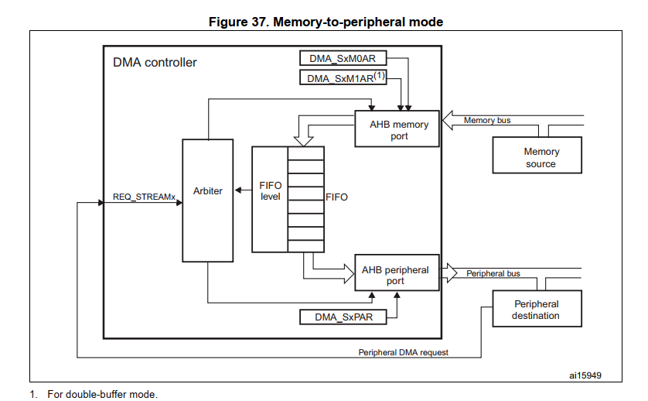
DMA – Memory-to-Peripheral mode

Slide 28
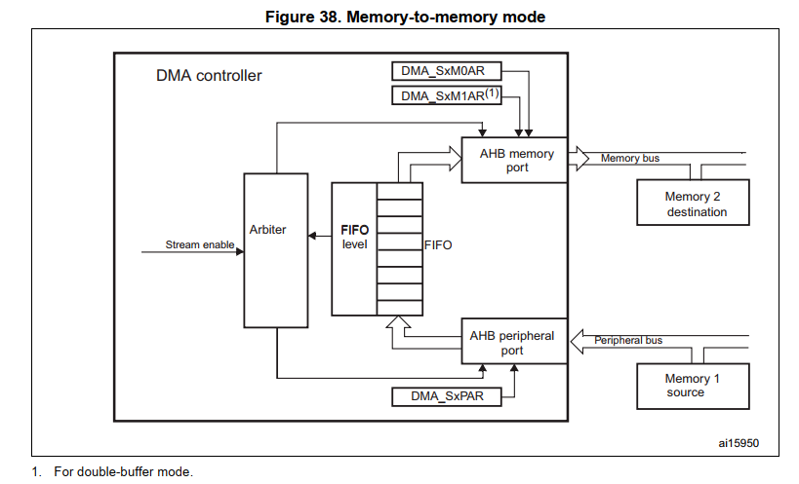
DMA – Memory-to-Memory mode

Slide 29
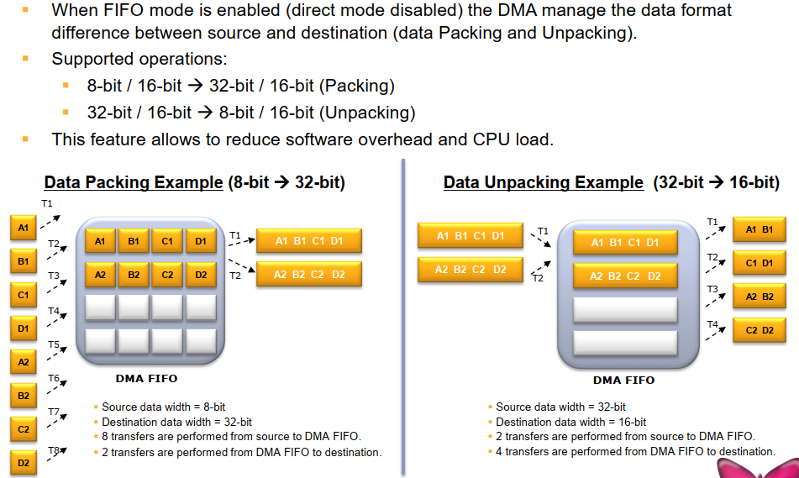
FIFO: Data Packing/Unpacking

Slide 30
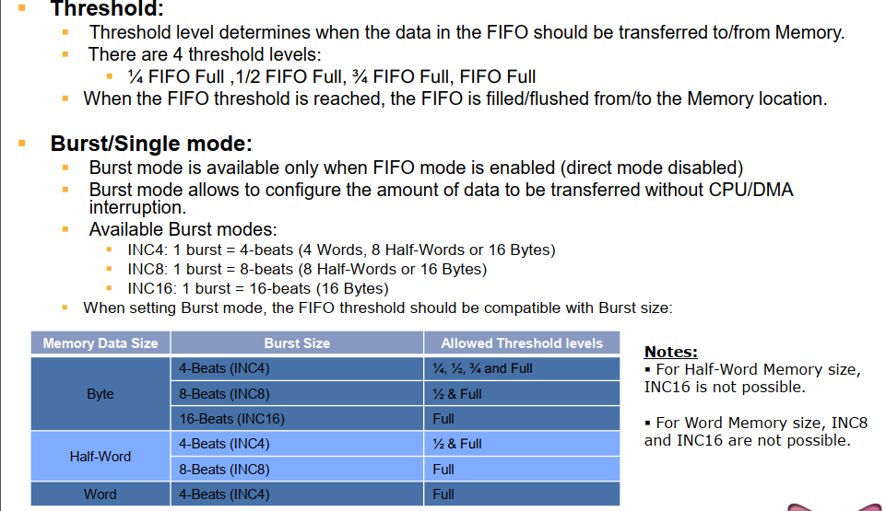
FIFO: Threshold & Burst mode

Slide 31
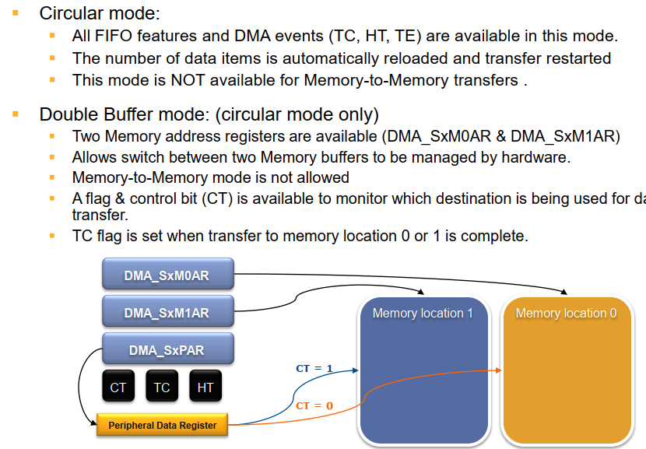
Circular & Double Buffer modes

Slide 32
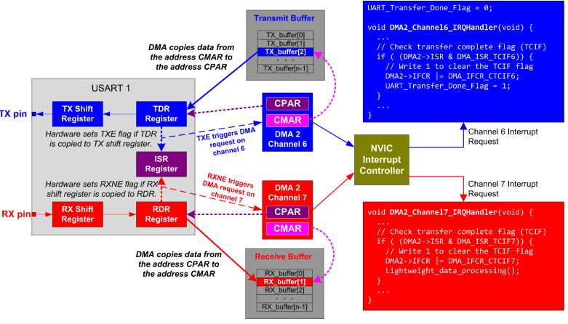
UART DMA: Receiving & Sending

Slide 33
Q&A

